Slide 1
Conceptualizing and studying space

Slide 2
Understanding space
Limitations of concept of space,
Lefebvre's definitions of "spatial illusion”
Two illusions:
First, is the "illusion of transparency" where space is viewed as being innocent and completely transparent to human comprehension.
The second, more prevalent amongst the spatial technicians, is what Edward Soja terms the "illusion of opaqueness“
or in Lefebvre's words "the realistic illusion", wherein space is accorded a reality that is purely defined by its materiality - what is seen is what it is. (physical view of space)

Slide 3
Contd.
Through the operation of these two "illusions" space is stripped of both its historicity and politics and the material environment is either seen as a neutral passive backdrop against which social life is played out
or, in more socially oriented spatial practices, space is seen as a reflection of society - a product of a particular social order/organization.
Dialectical relationship between material and social constructions of space
Also, space itself is an inherently embodied experience

Slide 4
Space; space and place
Space as more abstract – something that is more ‘conceptual’ than ‘real’
Space is socially produced – it is not simply there – a neutral container waiting to be filled but a dynamic, humanly constructed means of control and hence of domination, of power.
Space is a practiced place

Slide 5
Place – multiple senses of Place
Key idea is that Place = location + meaning.
Place as meaningful to people.
Place as dynamic and constantly changing.
Place as contested, transgressed and resisted by different groups i.e. people might challenge how a place is represented or perceived by the ‘majority’.
Place as creating people who are either insiders or outsiders.
People have the power to shape places around them – they create places by attaching meaning to them.

Slide 6
Space, place and power
Place is relational (Doreen Massey)
Made up of flows of people, ideas, technology and ideas
Space and place are infused with existing relations of power
Forces also act on a place, from global to local

Slide 7
Space and Gender
Space itself is an inherently gendered experience
Different bodies experience space differently depending on their gender, class, age, sexuality and physical ability
Access to space is socially and culturally determined by these differences
Yet architecture and planning assume space to be neutral
User assumed to be an upper class, able-bodied, heterosexual space

Slide 19
Gender and Space
Male and female spaces: Public/Private; Outside/Inside; Work/Home; Production/Consumption; Independence/Dependence Power/Lack of power
So space can structure inequalities, create or curtail opportunities
Space-Time continuum – spatially mobile bodies

Slide 20
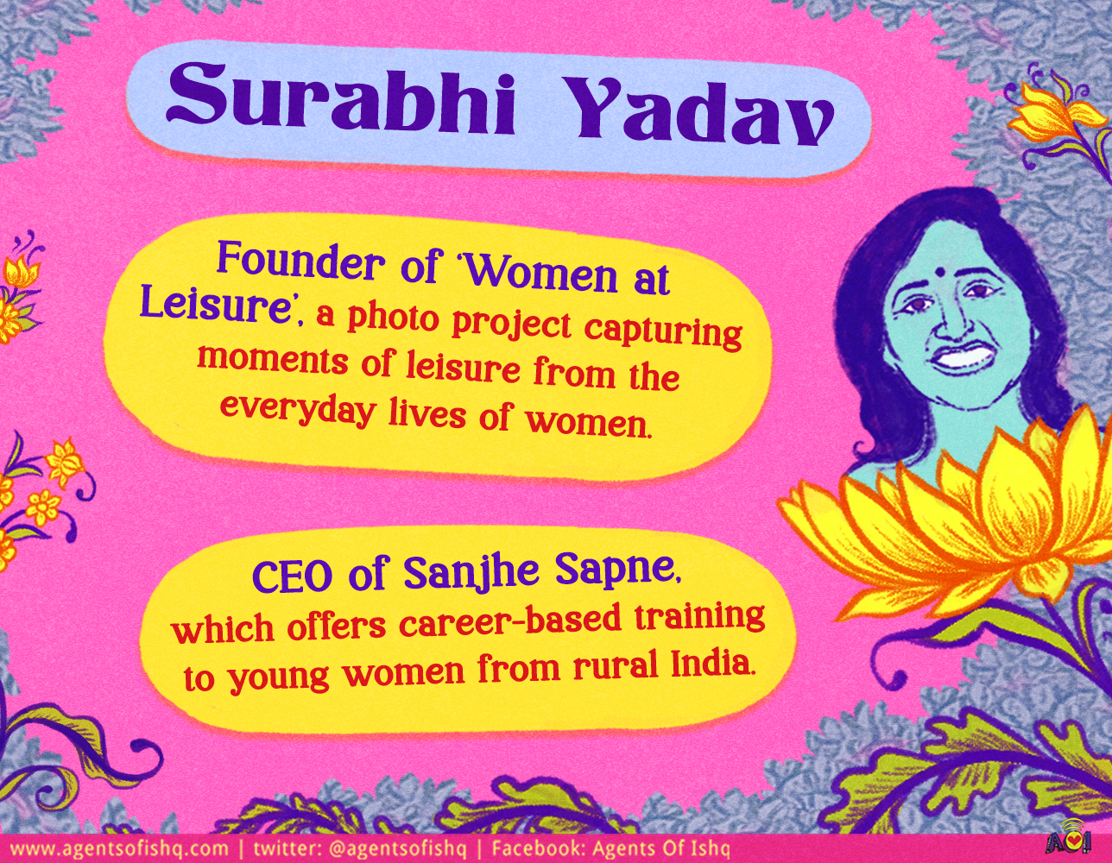
Women at Leisure

Slide 21
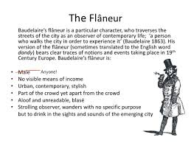
Flaneur, Flaneuse?

Slide 22
Leisure as a feminist issue – Surabhi Yadav (IITD B.Tech)
What happens when women claim their time to do absolutely nothing
Basanti - website
When can women be at leisure?

Slide 23

Why Loiter?

Slide 24
Gender and Space understood through mapping in an area of Mumbai
Study by Shilpa Ranade
“The Way She Moves: Mapping the Everyday Production of Gender-Space”

Slide 25
Mapping to understand space and place
Ways to map:
Stable features – built environment – land use, amenities – toilets, bus stops, telephone booths, police stations, trees, light posts, transportation hubs, taxis, rickshaw stands
Exercise 1 - Putting people in place - given a map on which participants place men and women of different ages in places they are most likely to be found at that time
Exercise 2 -Tracing people’s paths – negotiating a mixed-use space like a street with shops, restaurants, residences, park, industry – asked to mark the path the individual would take.

Slide 26
The study in Kalachowki – a neighbourhood in Mumbai
Exercise 1 - Counting gendered bodies - tells us how many men and women out there
But doesn’t tell us much more about where the women are located in space
Near schools? Near paan shops? Near bus stops?
Spaces and places that women frequent and tend to avoid
Safe/unsafe; comfort/discomfort (for instance near lottery shops)

Slide 27
Mapping women’s presence and movement
Mapping over a typical weekday and weekend
Time of the day (school children pickup time)
In coding entities on the map – moving vs stationary persons – a marker of difference

Slide 28
Mapping gender-space
Spaces get coded as male or female; if women are found in those spaces they are seen as “out of place”
Men at rest vs Women moving purposefully/ between one private space and another – women constantly moving
Men hanging out; multiple uses of the same space; men take the most interesting paths, where they are more visible
In tracing people paths, women cross the road several times to avoid situations in which they might find themselves uncomfortable/feel safe
Walk fast, makes themselves invisible
Men and Women at Nariman point lunch pickup time – differences
Differences by age?

Slide 29
What the mapping yielded - summary
When moving through public space women
(a) walk purposefully from one point to another and
(b) when walking, avoid such places as may be considered non-respectable such as lottery shops, and bars; or unsafe such as isolated lanes, dark footpaths.
(c)Women often choose the safest and most comfortable route even though it may be many times extended than the shortest route from one point to another.
(d)The purpose-defined movement of women is deeply connected to notions of respectability which define what good women should/should not do in public.
(e)In their movement through space women reproduce hegemonic discourses of femininity particularly that of respectable femininity.

Slide 30
How do women create acceptability in public space for themselves?
Findings fit into the larger hegemonic gender regime – where men have more power than women
Control of women's movement has been central to the maintenance of a gender regime informed by patriarchy
Therefore, women require legitimacy to be in public space
They need to “manufacture respectability” and “perform their femininity”- to generate safety for themselves
The idea of the “good woman” (remember the Nirbhaya rape)
“Self-policing”
Power structures re-inscribed through space

Slide 31
Legitimation and reproduction of the social order
Education becomes a legitimate pretext for women to access public space – whey they are young
Married women in their role as mothers

Slide 32
Women’s claim to space
At present, women have a “conditional” claim to space
Instead of asking for safety, should women not instead claim their right to public space?
Some women do subvert the gender code – travelling alone at night, going out to night clubs, smoking in public, working in call centres at night etc. – ability to subvert varies by class
Would this threaten the social order?
Job of the state to ensure safety

